Slide 1


Lecture 2 C++ Basics
PROGRAMMING 1
(CS 102)
2
Fall (2025-2026)

Slide 2
Course Learning Objectives
Explain and define fundamental programming concepts, including variables, data types, the sequential nature of program execution, and basic program input/output (I/O).
Trace and debug simple programs to identify and correct basic syntax and logical errors.
Apply basic programing concepts, such as conditional statements, loops, and functions, to solve small scale computational problems.
Decompose problems into smaller, manageable subroutines, and implement basic functions to enhance code modularity and reusability.
Collaborate with peers Work in a team to design and implement a software project that meets specific functional requirements.

Slide 3

Lecture 2: C++ Basics
C++ Variables and Assignment Statements
Constants

Slide 4
1. C++ Variables and Assignment Statements
C++ Variables
Variables are containers for storing data values
Every variable in a C++ program should be declared before usage
The declaration consists of type name and variable name and ends with a semicolon;
type variableName = value;
The general rules for naming variables are:
Names can contain letters, digits and underscores
Names must begin with a letter or an underscore (_)
Names are case sensitive (myVar and myvar are different variables)
Names cannot contain whitespaces or special characters like !, #, %, etc.
Reserved words (like C++ keywords, such as int) cannot be used as names

Slide 5

Data Types
int - stores integers (whole numbers), without decimals, such as 123 or -123
Float - stores floating point numbers, with decimals, such as 19.99 or -19.99
double - stores floating point numbers, with decimals, such as 19.99 or -19.99
char - stores single characters, such as 'a' or 'B'. Char values are surrounded by single quotes
string - stores text, such as "Hello World". String values are surrounded by double quotes
bool - stores values with two states: true or false

Slide 6
Data Types
(size in memory)
The data type specifies the size and type of information the variable will store:
Type | Size (bytes) | Range
char | 1 | -128 to 127 (signed) or 0 to 255 (unsigned)
short int | 2 | -32,768 to 32,767
int | 4 | -2,147,483,648 to 2,147,483,647
Float | 4 | ~ ±3.4E±38 (≈ 7 digits precision)
double | 8 | ~ ±1.7E±308 (≈ 15 digits precision)
bool | 1 | false (0) or true (any non-zero value, stored as 1)
string: holds a string of characters like words and sentences.
You must add string library #include <string>

Slide 7
Declaring (Creating) Variables
Assignment statement
type variableName = value;
Example
Create a variable called myNum of type int and assign it the value 15 :
int myNum = 15; cout << myNum;
int myNum; myNum = 15; cout << myNum;

Slide 8
Declaring (Creating) Variables
Assignment statement
A demonstration of data types:
int myNum = 5; // Integer (whole number without decimals)
double myFloatNum = 5.99; // Floating point number (with decimals)
char myLetter = 'D'; // Character
string myText = "Hello"; // String (text)
bool myBoolean = true; // Boolean (true or false)

Slide 9
Declare Many Variables
To declare more than one variable of the same type, you can use a comma-separated list:
#include <iostream>
using namespace std;
int main() {
int x = 5, y = 6, z = 50;
cout << x + y + z;
return 0;
}
Memory
x | 5
y | 6
z | 50
You can assign the same value to multiple variables in one line:
int x, y, z; x = y = z = 50; cout << x + y + z;

Slide 10
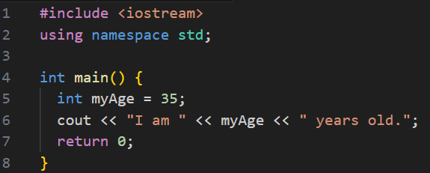
Display Variables
Example: display the variable myAge with value 35.
#include <iostream>
using namespace std;
int main() {
int myAge = 35;
cout << "I am " << myAge << " years old.";
return 0;
}

Slide 11
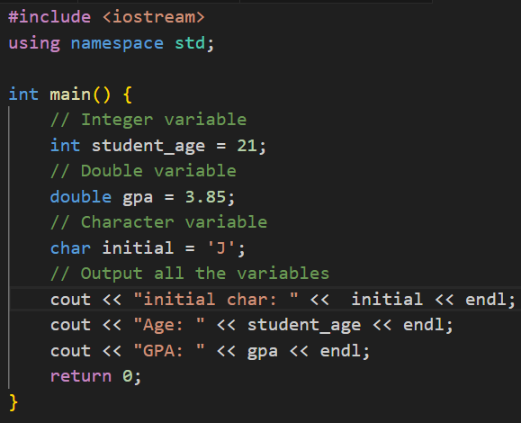
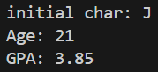
Example: Storing and Displaying Different Data Types
#include <iostream>
using namespace std;
int main() {
// Integer variable
int student_age = 21;
// Double variable
double gpa = 3.85;
// Character variable
char initial = 'J’;
// Output all the variables
cout << "initial char: " << initial << endl;
cout << "Age: " << student_age << endl;
cout << "GPA: " << gpa << endl;
return 0;
}

Slide 12
Creating a Simple Calculator
Add & Subtract
#include <iostream>
using namespace std;
int main() {
int x, y;
int sum,dif;
cout << "Type a number: ";
cin >> x;
cout << "Type another number: ";
cin >> y;
sum = x + y;
dif = x - y;
cout << "Sum is: " << sum<< endl;
cout << “difference is: " << dif;
return 0;
}
Notes:
Input-Process-Output

Slide 13

2. Constants
When you do not want others (or yourself) to override existing variable values, use the const keyword (this will declare the variable as "constant", which means unchangeable and read-only):
Example:
const int myNum = 15; // myNum will always be 15
myNum = 10; // error: assignment of read-only variable 'myNum'
You should always declare the variable as constant when you have values that are unlikely to change:
Example:
const int minutesPerHour = 60;
const float PI = 3.14;

Slide 14
Display constant variable
Example: display the constant variable week_ days with value 7.
#include <iostream>
using namespace std;
int main() {
// Variable declaration and initialization
const int week_ days = 7;
// Output
cout << "The number of days in a week is: " << week_ days << endl;
return 0;
}

Slide 15
Question: identify and fix the errors in the following code
#include <iostream>
using namespace std;
int main()
{
int i = k + 4;
cout << I << endl;
int i = 3;
cout << i << endl;
return 0;
}
#include <iostream>
using namespace std;
int main()
{
int i = k + 4;
cout << I << endl;
int i = 3;
cout << i << endl;
return 0;
}
Notes:
k is undeclared
I vs i (case-sensitive)
Redeclaration of i

Slide 16



